Slide 1


Presentation II- Requirements
9th May 2018 Team ATOM

Slide 2
TABLE OF CONTENTS
User Stories
Use Case Diagrams
Requirement Gathering
Requirement Analysis
Requirement Finalization
Wrong Interpretations
Kanban Board
9^{t}

Slide 3

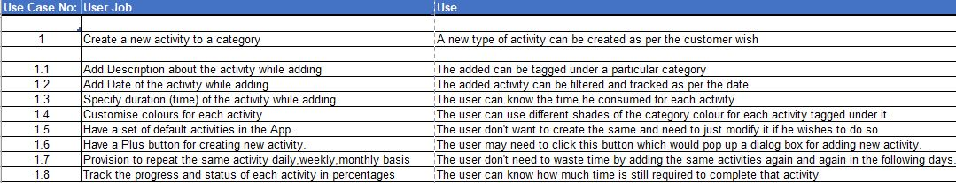
USER STORIES 1/3
User Case 1- Create new activity to a category

Slide 4
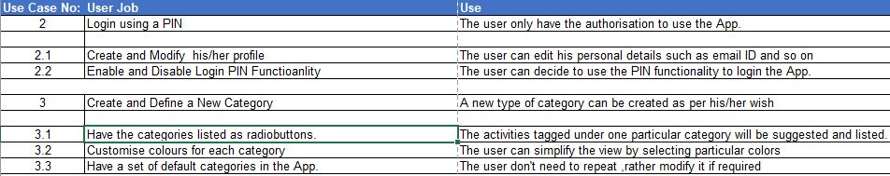
USER STORIES 2/3
User Case 2 - Login using a PIN
User Case 3 - Create/Define a new category

Slide 5
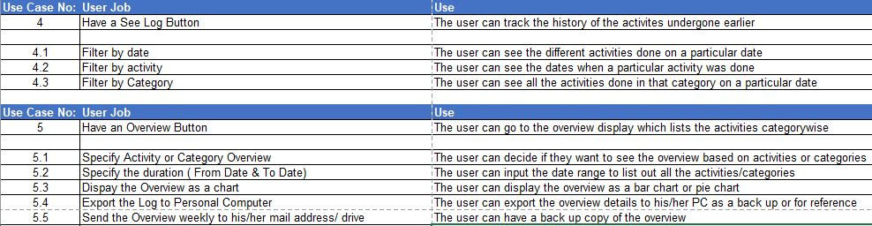
USER STORIES 3/3
User Case 4 – Have a “See Log” button
User Case 5 – Have an Overview button

Slide 6
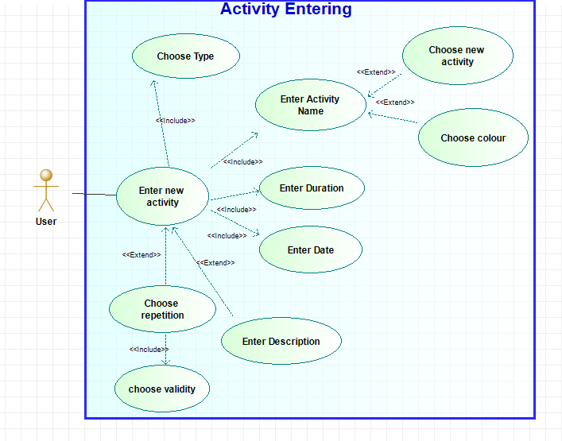
USE CASE DIAGRAM 1/2
New activity creation to a category

Slide 7
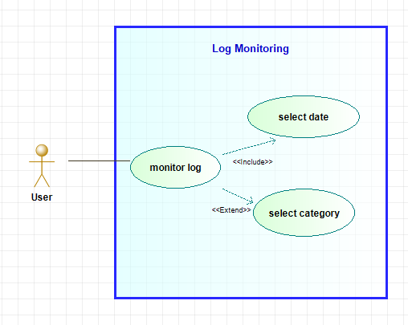
USE CASE DIAGRAM 2/2
“See Log” button

Slide 8

REQUIREMENT GATHERING
Three face to face discussions with the customer.
Understood what customer expects and noted all possible features for decision making.
Offered couple of extra innovative features which is unique in all perspectives.
Literature survey to study the feasibility of the requirements.

Slide 9
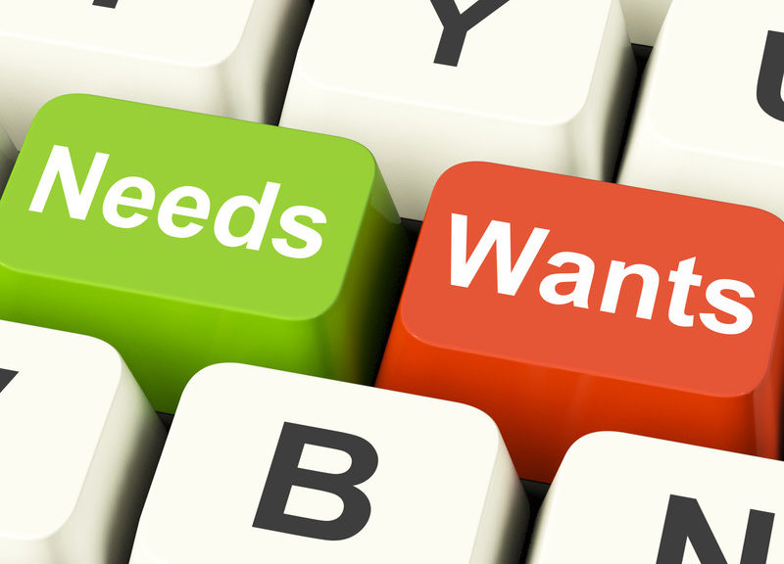
REQUIREMENT ANALYSIS 1/2
Internal team meetings to list out all the options that can be offered to the customer .
Brainstorming and thinking like business analysts.
Feasibility check of the functional(what the system) and non- functional(how good) features.
Prioritizing requirements to ensure consistency and customer satisfaction.

Slide 10

REQUIREMENT ANALYSIS 2/2
Design prototyping to categorize the requirements and eliminate conflict or ambiguity.
Preparing pictorial representations for better understandability to the customer.
Adapted to the changes and suggestions put forward by the customer

Slide 11

REQUIREMENT FINALIZATION
Formulated the time required for each phase of app development.
The pictorial representation of the final product played a key role in categorizing the user story/ diagrams.
Go ahead signal from customer when the explanations were satisfactory and precise.

Slide 12

WRONG INTERPRETATIONS
Post first meeting with the customer, certain requirements were interpreted in a different way for which clarity was sought in the next meetings.
Example:- One among the few cases was the LogIN feature which was planned initially as a mandatory part of the app. However, the customer suggestion was to make it optional since users hate a login with a pin entry every time.Finally, this suggestion was corrected in the requirement notes.
12

Slide 13
KANBAN BOARD
Backlog
To do
In Progress
Development
Testing
Final
Nil
Next PPT
Final Design
Next Blog
Blog 2
Development
Activity Tracker

Slide 14
Image References:
Slide 8 : https://flexibleworksolutions.com/2015/04/07/face-it-face-to-face-is-important/
Slide 9 : http://www.torontotechnologies.ca/category/requirement-analysis/
Slide 10 : https://qtsin.com/dass-services.htmlSlide 4 : http://suggestive.com/sound-smart-politics/
Slide 11 https://www.salesforce.com/blog/2014/04/crm-tips-going-beyond-the-handshake.html
Slide 12 : https://www.mycustomer.com/service/channels/infographic-how-retailers-can-turn-consumer-confusion-into-omnichannel-activity
Activity Tracker

Slide 15

Team ATOM

